Slide 1
INSERT PSA NAME LOGO
SAFE SPORT

Slide 2
WHAT IS SAFE SPORT?
A commitment and initiative to prevent and address maltreatment in sport, ensuring sport environments are free from abuse and harassment.
HOW CAN YOUR ORGANIZATION SUPPORT SAFE SPORT?
Commit to the National Safe Sport program
Build awareness amongst all members
Create an inclusive & safe culture within the organization

Slide 3
For Sailing the Vision
related to Safe Sport initiatives:
Athletes, coaches, officials, and volunteers have the right to participate in a safe and inclusive sport environment that is free of maltreatment (abuse, harassment or discrimination)
We are working actively and intentionally to protect that right

Slide 4
National Policy
Provincial Policy
Impacted by Provincial Requirements
Local Policy
Impacted by Local Regulations
HARMONIOUS
Notes:
Note that Sail Canada adopted on November 22nd 2022

Slide 5
HARMONIZED APPROACH
The substantive and procedural aspects of all policies should be the same at the national, provincial and community level
Standards of behaviour & conduct should be consistent
Harmonized takes pressure off each level of sailing in Canada
Resources Invested Once – thousands of dollars & hours
Canadian sailing organizations are handed an almost complete tool

Slide 6
POLICY PACKAGE Prevention
Code of Conduct with UCCMS
Universal Code of Conduct to Prevent & Address Maltreatment in Sport
Screening Policy
Protection Policy
Social Media Policy
Whistle Blower Policy

Slide 7
UCCMS PROHIBITED BEHAVIOURS
Maltreatment (Psychological; Physical; Sexual Maltreatment)
Neglect
Harassment
Interfering/Manipulation of Process
Retaliation
Grooming
Aiding & Abetting
Failure to Report
Notes:
Highlight that in addition to the Code of Conduct with base expectations we adopted the UCCMS which highlights serious behaviours that will not be tolerated.

Slide 8
A Person in Authority should never be alone
with an athlete

Slide 9
POLICY PACKAGE Response
Discipline & Complaints Policy
Appeal Policy
Dispute Resolution
Discipline & Complaints is key policy with very detailed procedures
Weight of work associated will rise upwards in organization
Hope to never use but need be prepared because reality is we will need them
Robust policies DO NOT mean that the number of cases to be dealt with will increase significantly; however, when there are cases, it is best to be prepared to handle them properly

Slide 10
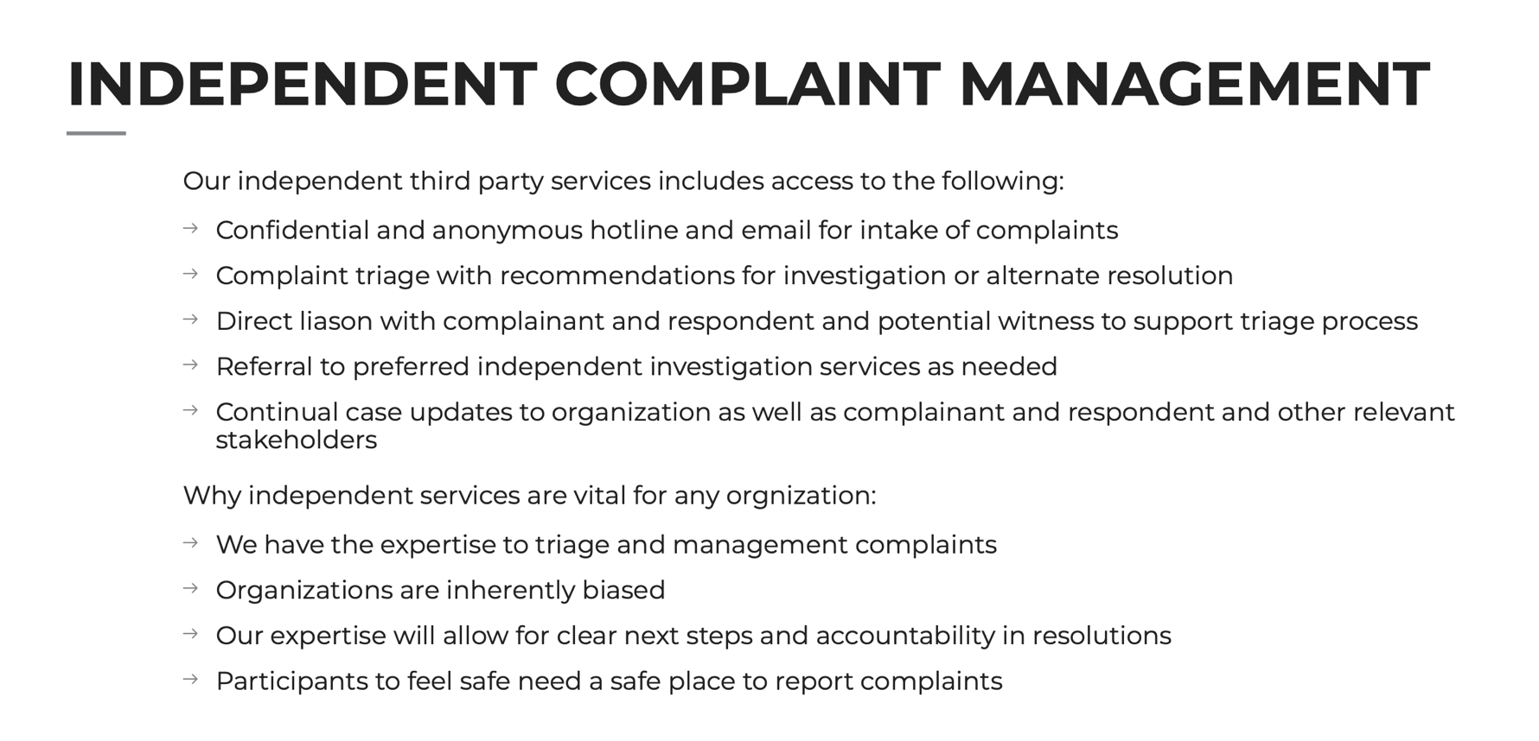
ALL CONCERNS - REPORT ONLY TO:
Independence Third Party (ITP) is KEY at all levels
Notes:
Highlight the reporting system is independent – not to come to club President or to PSA staff/Board

Slide 11
INDEPENDENCE IS KEY
At all levels ensuring the process is independent from staff and Directors is important to future scrutinization
Reporting & Triaging
Easy to report concerns, let professional determination seriousness of reported complaint.
Resolution
Need a case manager and a mechanism outside of Staff/Board
Ensure No Conflict of Interest

Slide 12
WHO’S WHO’S
Sport Dispute Resolution Centre Canada (SDRCC)
Abuse Free Sport
Independent program, operated by SDRCC
Provides a hub for resources and tools nationally
Operates the Canadian Sport Helpline
Office of Sport Integrity Commissioner (OSIC)
Independent program of SDRCC
Responsible to administer UCCMS
Pillar of Abuse Free Sport managing complaints
ITP Sport
Sail Canada’s Identified Independent Third Party Reporting Mechanism

Slide 13
OSIC
Complaint Form
Identified as not a UCCMS Participant and/or not a UCCMS related breach
SDRCC redirects to
ITP Sport
(Provincial Government)
If respondent is UCCMS Participant & UCCMS breach
(see list identified)
OSIC will Manage
Sport Canada funds
If complaint not valid, doesn’t go anywhere
Based on policy
ITP determines if National/Provincial /Community Level
ITP determines Process #1 -Non UCCMS/Minor complaint
Process #2 – UCCMS/Major
Canadian Sport Helpline
Independent Third-Party Reporting Process
Notes:
Discuss importance of independent professional triaging

Slide 14
Who are UCCMS Participants?
All registered Coaches/Instructors
All registered Officials
All National Team Athletes and Athlete Support Personnel
Sail Canada Board, staff, and volunteers
For the time period they are attending the event only– Athletes at National Training Camps or National Championships
WHAT THIS MEANS
OSIC will manage any UCCMS related alleged breaches that involves one of the above people as the respondent to the complaint.
Notes:
Pressure is off clubs to manage if a situation with a coach or official arises

Slide 15
WHERE DO I START?
Review & become familiar with UCCMS v6 https://sportintegritycommissioner.ca/files/UCCMS-v6.0-20220531.pdf
Complete the Safe Sport Training Module - Coach Association Canada (Free 60-90 minute e-learning session)
https://safesport.coach.ca/concerned-individuals
Identify a Safe Sport Lead to champion this for your organization

Slide 16
What is a Safe Sport Lead?
The individual who is the main point of contact and will oversee the implementation of tasks and adherence to timelines for adoption of the Safe Sport Policy Suite at their organization
Committed to champion this initiative & passionate about Safe Sport
Understand concepts of governance, legislation, policies and procedures
Be comfortable leading discussions, training, and communication
Ongoing support for community level organizations
This role is NOT involved in the Complaint Management process
Notes:
Adam/Jen

Slide 17
Implementation Plan
Phase 1: Preparation
Find a Safe sport Lead
Review Policies – what is being replaced?
Phase 2: Awareness, Training & Education
Educating leadership group
Starting to build awareness & understanding with members
Phase 3: Adoption of Policies
Board approval
Archiving old policies
Phase 4: Implementation
Communication and notification
Training & Acknowledgements - updated files with new documentation
Screening procedures implementation

Slide 18
Safe Sport Policy Implementation
Board Adopts Policy Package
Key Roles Identified
SCREENING Requirements for all leaders completed
Training & Resources (CAC Safe Sport Module etc.)
COMMUNICATION
Everyone: Code of Conduct
Coaches & Teams:
Protection Policy
Post Policies on website
Post Info on how to Contact ITP etc.

Slide 19
Safe Sport not just a policy to check a box
It is our culture!
This will take time – engagement, commitment & communication
Together we CAN make change

