Slide 1
ALBERTA SAILING ASSOCIATION
SAFE SPORT LEAD TRAINING
Safe Sport Leads

Slide 2
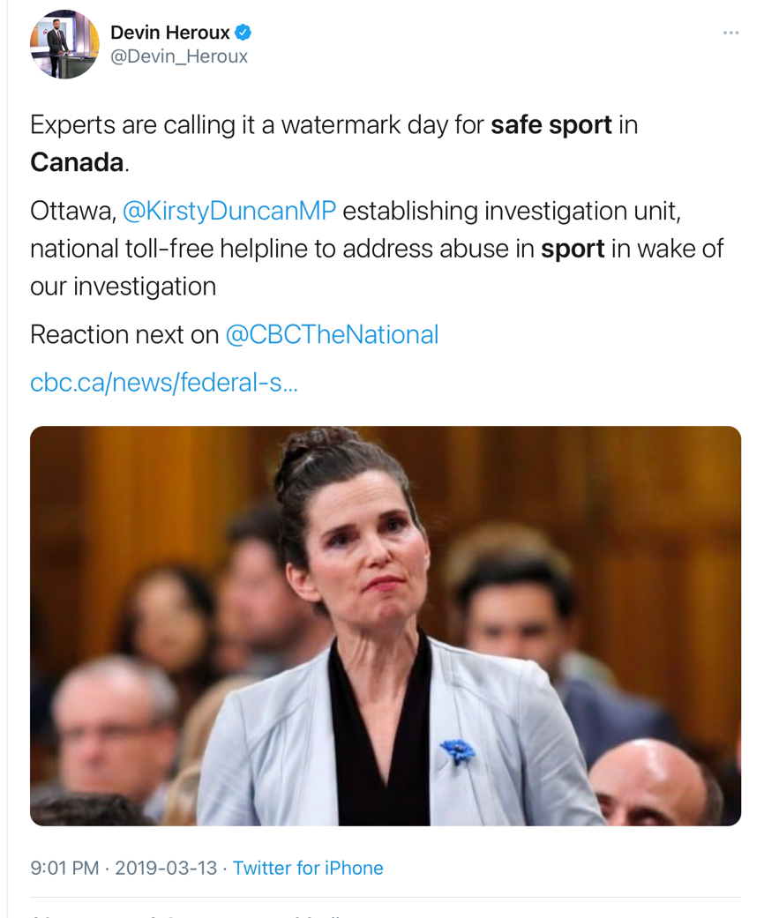
SAFE SPORT
CBC Investigation (Feb 2019)
Over 20 years - 340 Coaches Charged with Sexual Offences against Minors
600 Victims, 222 Convictions, 34 ongoing cases
Spanned 36 sports

Slide 3
National Policy
Provincial Policy
Impacted by Provincial Requirements
Local Policy
Impacted by Local Regulations
HARMONIOUS
Notes:
Note that Sail Canada adopted on November 22nd 2022

Slide 4
HARMONIZED APPROACH
The substantive and procedural aspects of all policies should be the same at the national, provincial and community level
Standards of behaviour & conduct should be consistent
Harmonized takes pressure off each level of sailing in Canada
Resources Invested Once – thousands of dollars & hours
Canadian sailing organizations are handed an almost complete tool

Slide 5
WHAT IS SAFE SPORT?
A commitment and initiative to prevent and address maltreatment in sport, ensuring sport environments are free from abuse and harassment.
SUPPORT SAFE SPORT
Adopt the Safe Sport Policy Package
Build awareness amongst all members, staff, volunteers
Create an inclusive and safe culture within our organization
Actively Implement Policies – Screening & Protection

Slide 6
THE POLICY PACKAGE
DEFINITIONS
One set full package
PREVENTION
Codes of Conduct
Protection Policy
Social Media Policy
Screening Policy
Whistle Blower
RESPONSE
Discipline & Complaints Policy
Appeal Policy
Dispute Resolution Policy

Slide 7
PURPOSE OF THESE POLICIES
To create
consistent expectations and implement a nationally aligned support system to respond to situations

Slide 8
Most Common Misconceptions
MYTH – We don’t have a need. Everyone is well intentioned and gets along
REALITY – It just takes one! 30-40% of marriages end in divorce.
MYTH – We don’t have time & resources to deal with this
REALITY – When something happens it will be too late and resources will be very strained if nothing in place – need preventative work now!
REALITY – Without these policies you still have to manage situations with higher costs
MYTH – We can handle any issues ourselves
REALITY – Clubs that have gone through situations often discover their policies not thorough enough and often look to the PSA for support.
Legal fees, time and expertise become a lot regardless of club size.

Slide 9
“Reasonable & Fair”
Every situation will be uniquely different
The policies provides structure and guidance to support leaders of organizations
A level of judgement will always be needed – goal is to be fair & reasonable
The document will evolve with time and experience –
as we know more we’ll do better
Learn as we go

Slide 10
Process – Key Steps
TIPS
Each club is different! Don’t compare, know your group and culture
Preparation
Identify & Register Safe Sport Lead ✔️
Review By-laws
Review current and new policies
Find & Replace “[CLUB NAME]” in documents
Assess resources (Human/$) - how are you currently managing this area?
Who could be involved in Internal Discipline Process

Slide 11
Process – Key Steps
Awareness & Education
Attend session for Safe Sport leads ✔️
Build awareness & understanding with key stakeholders
Adoption
Board adopts policy – Due by March 31st (Effective April 1st)
Confirmation to PSA upon signing
Provide Sign Off to Sail Canada if requested

Slide 12
TIPS
Archiving – important step to protect in case of historical cases
Date documents correctly & save!
Maintain records
Process – Key Steps
Implementation
Communication with stakeholders
Training
Documentation completed – proof of training, agree to codes of conduct, screening disclosures (We will provide forms)
Archiving old policies
Public availability of new policies

Slide 13
Process Questions
Contact Info at bottom of page – what do we include?
Club name, club address, website and email address - no individual information but the organization information you would put on an official policy or document
Do we need a legal budget?
Suggested to be prepared, what would happen now if a situation were to arise, clubs dealing with situations in the last few years have have good size legal bills to manage.
This policy does put some supports in place through Sail Canada but some funds in reserve should you ever have a legal situation would be good risk management procedures.

Slide 14
Process Questions
What do people need to sign, what do people need to read, how do we share?
Sign
Code of Conduct from package
Post Publicly
How to contact ITP/OSIC
All Policies
Documentation of other items such as safety education is important

Slide 15
OTHER QUESTIONS ON PROCESS?
HOW & WHY

Slide 16
UCCMS
Universal Code of Conduct to Prevent and Address Maltreatment in Sport
Created by athletes for athletes
Addresses the most serious breaches
Separates maltreatment from misconduct
Read at link provided, may be updated at various times

Slide 17
Key Definitions
TIPS
In document capitalized words are defined
Maltreatment
Any volitional act by an individual that results in harm or the potential for physical or psychological harm to another Individual,
Psychological verbal – personal criticism, body shaming,
Non assaultive physical – throwing things or punching objects
Denying Attention – abandonment as punishment, denying feedback or training opportunities
Physical - Contact or Non Contact – forcing isolation, providing alcohol to minor, painful stance for no purpose, denying food, drink, medical attention, allowing early return from injury
Sexual
What does that look like in Sailing

Slide 18
Key Definitions
Neglect
Any pattern, or a single serious incident, of lack of reasonable care, inattention to an Individual’s needs, nurturing or well-being, or omissions in care.
Neglect is determined by the objective behaviour but the behaviour must be evaluated with consideration given to the Individual’s needs and requirements, not whether harm is intended or results from the behaviour.
What does that look like
Not providing recovery time from injury
Not considering disabilities
Not providing supervision of athletes
Not considering welfare of athlete in weight control methods (caliper tests)
Failure to ensure safety
Allowing them to disregard rules, regulations

Slide 19
Grooming & Gatekeepers
Slow gradual & escalating process of building comfort and trust with an athlete and/or their parents/guardian
Often very difficult to recognize
Allows for inappropriate conduct to become normalized
Often preceded by building confidence and comfort that an individual can be trusted with the care of the athlete.
What does that look like
Favouritism, extra time and attention, gifts
All appears innocent and well intentioned
Private communication – social media/text, personal photos
Private travel, meetings, time together

Slide 20
Code of Conduct
Provides the expectation of appropriate behaviour at all times for everyone and a commitment to follow all policies in place
Everyone
Maintain and enhance the dignity & self esteem of others
Refrain from maltreatment or prohibited behaviour
Abide by all laws and organizations policies
Respect property of others
In sailing activities Adults not being under the influence, Minors not consuming alcohol etc.
Athlete Support Personnel
Provide necessary information
Ensure a safe environment
Recognize the power imbalance between you and an athlete, and act accordingly
Act in athlete’s best interest
Never condone use of drugs or prohibited substances
Sections for Board, Staff, Parents, Officials
Notes:
Key expectation takeaways included on screen.

Slide 21
Protection Policy
Policy lays out what is acceptable safe sport environment & actions
Practices and Events
Communications
Virtual Settings
Travel
Locker Room/Changing Area
Photography/video
Physical Contact
A Person in Authority must follow Rule of Two

Slide 22
A Person in Authority should never be alone
with an Athlete

Slide 23
How do we make Rule of Two work?
For example: Before & After Practice
Pickup and drop off should be timed with practice start and end times.
Participants wait in car, outside until multiple have arrived
What does Open & Observable look like?
For example: Participant meetings or 1 on 1 Coaching
Outside, visible and within earshot distance of another coach, screened volunteer, parent, or adult.
Notes:
Adherence to the Rule of Two is strongly recommended in any situation that involves athlete/coach interaction, and must be implemented with practical considerations in mind. This includes athlete meetings, coaching on and off the water, in electronic communication, etc. Minimum requirements are set out in Section 3 of the Athlete Protection Policy if full adherence can’t be achieved.
Medical emergencies are an exception to the Rule of Two.

Slide 24
Education & Preparation
Communication with Participants & Parents
Know expectations, understand the “why”
Be proactive in ensuring everyone knows what’s acceptable
Everyone has a role to play!

Slide 25
Protection /Codes of Conduct FAQ
Protection Policy prohibits using “embarrassing images”. This seems an overly broad term. Provided there is consent, why would such an image be prohibited?
Recognize what’s embarrassing to me may not be embarrassing to someone else, it is in eye of individual
Do you get consent before posting on social media for every image?
Reasonableness comes into play but need to be respectful of everyone’s differences and comfort
Communications between adult participants & instructors for interactions outside of sailing? For instance, many of our volunteer coaches are friends of other adult sailors and communicate with them to go skiing, hiking, for coffee, etc.
The focus of these are really on a power imbalance, for a recreational sailor the person in authority has no real power over the sailor - the sailor is not needing approval from the coach to progress in sport there is no power imbalance between adults of similar age in a recreational setting.
Sailing interactions should follow the guidelines set out and be kept professional. Outside interactions in the winter etc. when neither individual is acting as a person in authority and the friendship is separate from sailing is not meant to be stifled. Reasonable judgement to assess potential power imbalance is assumed.

Slide 26
Social Media Policy
What is acceptable behaviour under the Code of Conduct and Protection Policy also applies to social media use
Always keep others information private
Individuals always have the right to ask sailing organizations to disengage with them on social media
Remember:
Anything you post could be seen by anyone.
Deleting media afterwards does not remove the possibility of sanctions.
What you post represents you and the sport.
Notes:
Falling short of the standard of behaviour required by the Social Media Policy and the Code of Conduct may be subject to the disciplinary sanctions identified in the Discipline, and Complaints Policy.

Slide 27
Screening Policy
Outlines the expectations around Member Organizations to screen personnel and volunteers
Screening is not just criminal record checks!
Resumes/applications, interviews, references, training all part of screening
Screening matrix determines what screening is completed based on job role/responsibilities
Everyone will complete some level of screening
Screening done at initial start with annual & 3-year renewals
Ask Staff/Volunteers to sign off on Screening Disclosure Forms which requires disclosure of past and guarantee to update if needed

Slide 28
Screening Policy Questions
Is Sail Canada looking after all these duties or do we need this committee
Screening is not just criminal record checks
Sail Canada has a process in place for Criminal Record Check for coaches/instructors but rest is organization’s responsibility.
What happens if a report says something we don’t know how to deal with?
Connect with your PSA – we can support you with complex situations if you are unsure

Slide 29
Discipline & Complaints Policy
The main policy to deal with alleged breaches of preventative policies
Independent 3rd Party
National
Provincial
Local Orgs
Minor issues dealt at level they occur (Process #1)
Coaches/Instructors/Officials fall under Office of Sport Integrity Commissioner for UCCMS related breaches
Notes:
Minor complaints are dealt with at the level that they occur.
New: a systematic ladder to complaint management, including an Appeal process.
More serious complaints are reported to RCA’s Independent Third Party (ITP), who determines when a Reported complaint is handled by either the Club’s Complaint Resolution Officer (CRO) or by the affiliated Provincial Rowing Association.
The role of the Independent Third Party is to triage complaints for validity & to determine who’s responsible for managing it
provides support from PSO/NSO

Slide 30
Discipline & Complaints
Policy outlines detailed process
Independent Third Party – Triage for validity & responsibility for managing
14 days to report a complaint in writing to ITP
Systematic ladder to complaint management:
provides support provincially & nationally
Important to know & respect – Confidentiality & privacy systems in place

Slide 31
Investigations Process
Investigations conducted when Independent Third Party determines there is a need for an independent investigation
ITP will appoint an investigator
Independent investigator with training/experience
Report goes back to ITP who then proceeds based on report

Slide 32
INDEPENDENCE IS KEY
At all levels ensuring the process is independent from staff and Directors is important to future scrutinization
Reporting & Triaging
Easy to report concerns, let professional determination seriousness of reported complaint.
Resolution
Need a case manager and a mechanism outside of Staff/Board
Ensure No Conflict of Interest

Slide 33
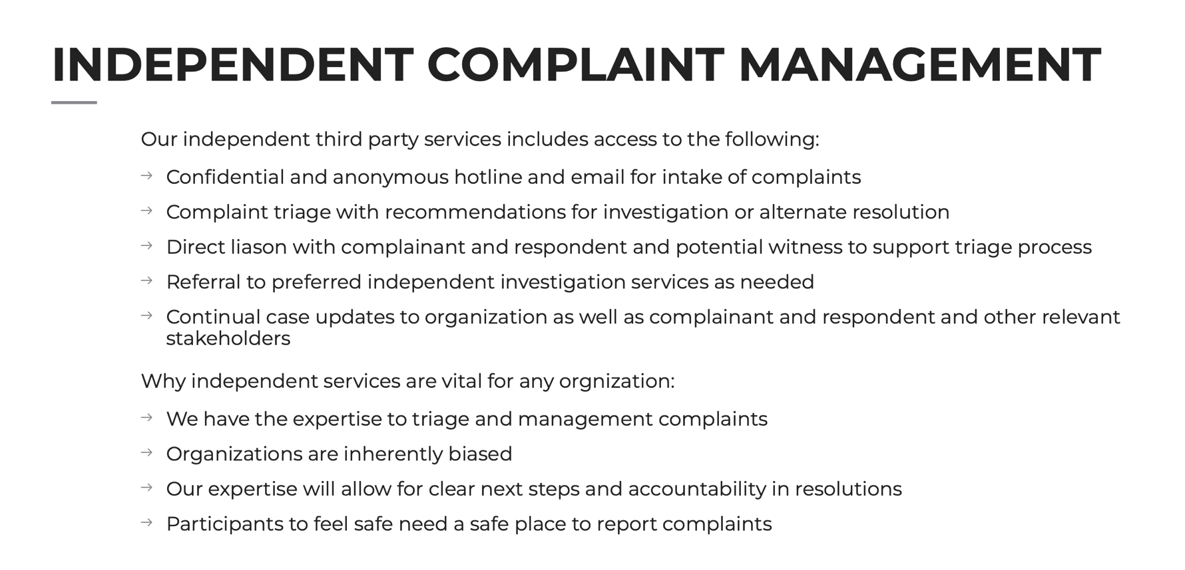
ALL CONCERNS - REPORT ONLY TO:
Independence Third Party (ITP) is KEY at all levels
Notes:
Highlight the reporting system is independent – not to come to club President or to PSA staff/Board

Slide 34
WHO’S WHO’S
Sport Dispute Resolution Centre Canada (SDRCC)
Abuse Free Sport
Independent program, operated by SDRCC
Provides a hub for resources and tools nationally
Operates the Canadian Sport Helpline
Office of Sport Integrity Commissioner (OSIC)
Independent program of SDRCC
Responsible to administer UCCMS
Pillar of Abuse Free Sport managing complaints
ITP Sport
Sail Canada’s Identified Independent Third Party Reporting Mechanism

Slide 35
ITP / OSIC
Complaint Filed
Identified as not a UCCMS Participant and/or not a UCCMS related breach
SDRCC redirects to
ITP Sport
(or Provincial Government)
If respondent is UCCMS Participant & UCCMS breach
(see list identified)
OSIC will Manage
Sport Canada funds
If complaint not valid, doesn’t go anywhere
Based on policy
ITP determines if National/Provincial /Community Level
ITP determines Process #1 -Non UCCMS/Minor complaint
Process #2 – UCCMS/Major
Canadian Sport Helpline
Independent Third-Party Reporting Process
Notes:
Discuss importance of independent professional triaging

Slide 36
Who are UCCMS Participants?
All registered Coaches/Instructors
All registered Officials
All National Team Athletes and Athlete Support Personnel
Sail Canada Board, staff, and volunteers
For the time period they are attending the event only– Athletes at National Training Camps or National Championships
WHAT THIS MEANS
OSIC will manage any UCCMS related alleged breaches that involves one of the above people as the respondent to the complaint.
Notes:
Pressure is off clubs to manage if a situation with a coach or official arises

Slide 37
Discipline & Complaints FAQ
How does one reach Independent Third Party ?
The contact information is available on the Sail Canada website, the PSA’s website and it should be posted on your website with your policies
There will be a poster downloadable from Sail Canada website also it will be sent to Safe Sport Leads to post around your club, boat, etc.
Support is available 24/7 via email or phone
What happens while we wait for a complaint to be resolved?
See the provisional suspension section of policy
Every situation is different, but this process doesn’t change from what you would do now
Reasonable accommodations for alternate situations during all phases of investigation for all parties if suitable to situation – minors vs majors, type of situation

Slide 38
Appeal Policy
The process to appeal decisions related to policies.
Provides individuals with a fair, affordable, and expedient appeal process for those who have been affected by a decision taken by your club that concerns:
A conflict of interest
Disciplinary decisions made pursuant to your club’s relevant and applicable policies
Membership
Grounds for appeal
Decision outside of jurisdiction, didn’t follow procedures, influenced by bias or grossly unfair

Slide 39
Dispute Resolution Policy
Opportunities for Alternate Dispute Resolution (ADR) may be pursued at any point in a dispute when all Parties to the dispute agree that such a course of action would be mutually beneficial.
Facilitation and Mediation
If all Parties to a dispute agree to ADR, a mediator or facilitator, acceptable to all Parties, shall be appointed to mediate or facilitate the dispute.

Slide 40
QUESTIONS ON POLICIES?

Slide 41
Also Note
Confidentiality
Is important to the organization and everyone involved. Please do your part!
Information obtained will be kept confidential unless disclosure is necessary to protect workers, to investigate the complaint or incident, to take corrective action or otherwise as required by law.
Privacy Policy
These policies reference your organization’s Privacy Policy due to nature of information and confidentiality
If you do not currently have a privacy policy a template can be provided to you.

Slide 42
Other Questions?
Everyone has a role to play in making our club
a Safe Sport environment.
Thank you for your attention and commitment!

